Slide 1
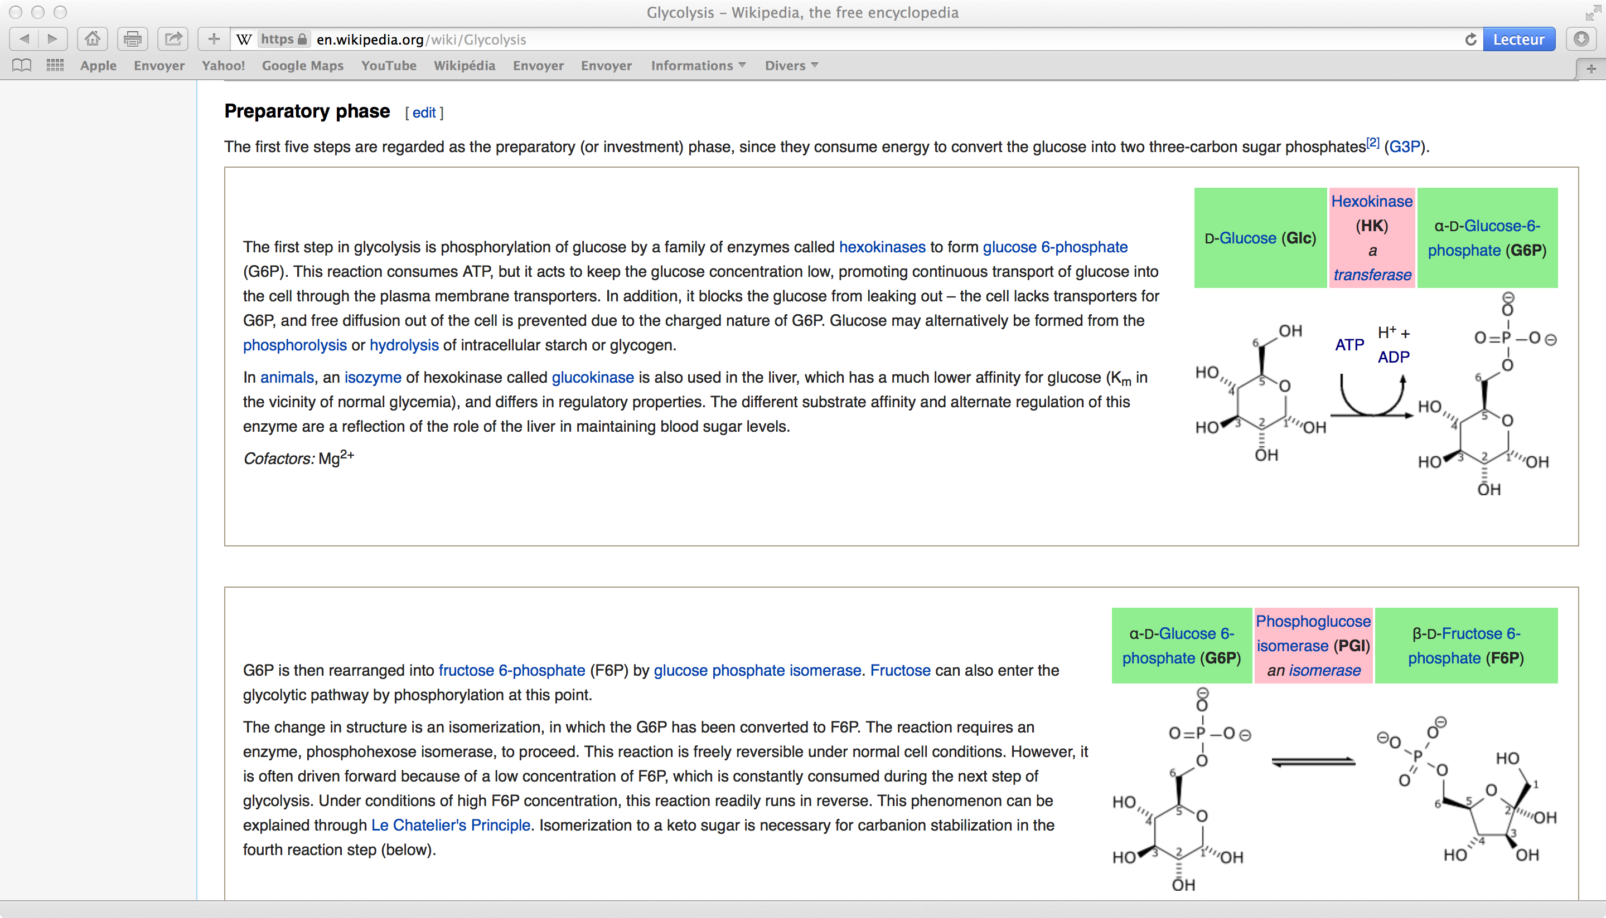
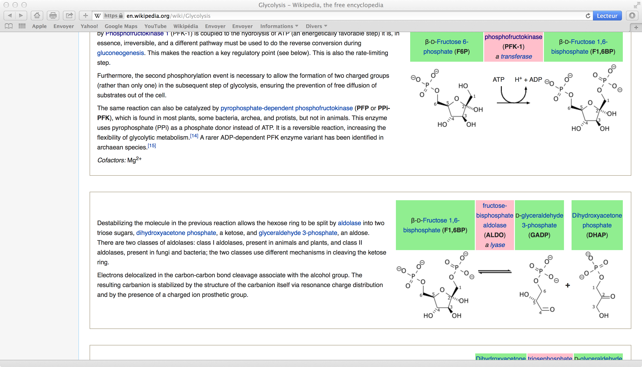
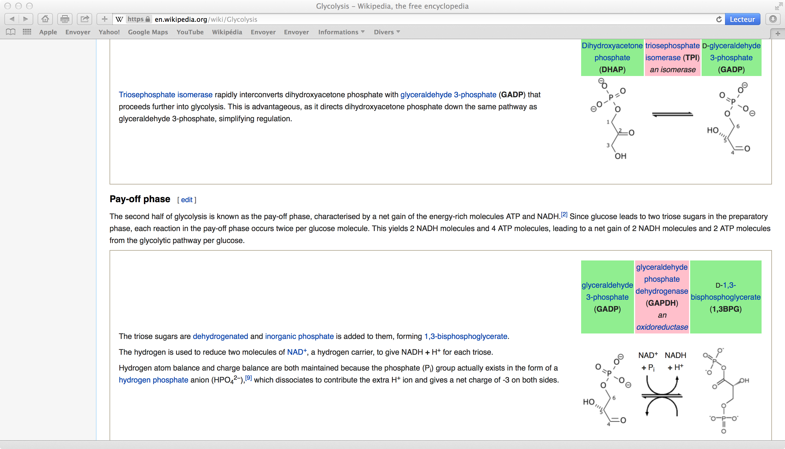
We need to Count Protons
Glucose
Glucose 6P
Fructose 6P
Fructose 1-6 diP
+1
+1
1-3 Bisphosphoglycerate
2X Glyceraldehyde 3P
2X
2X
H
+2

Slide 2
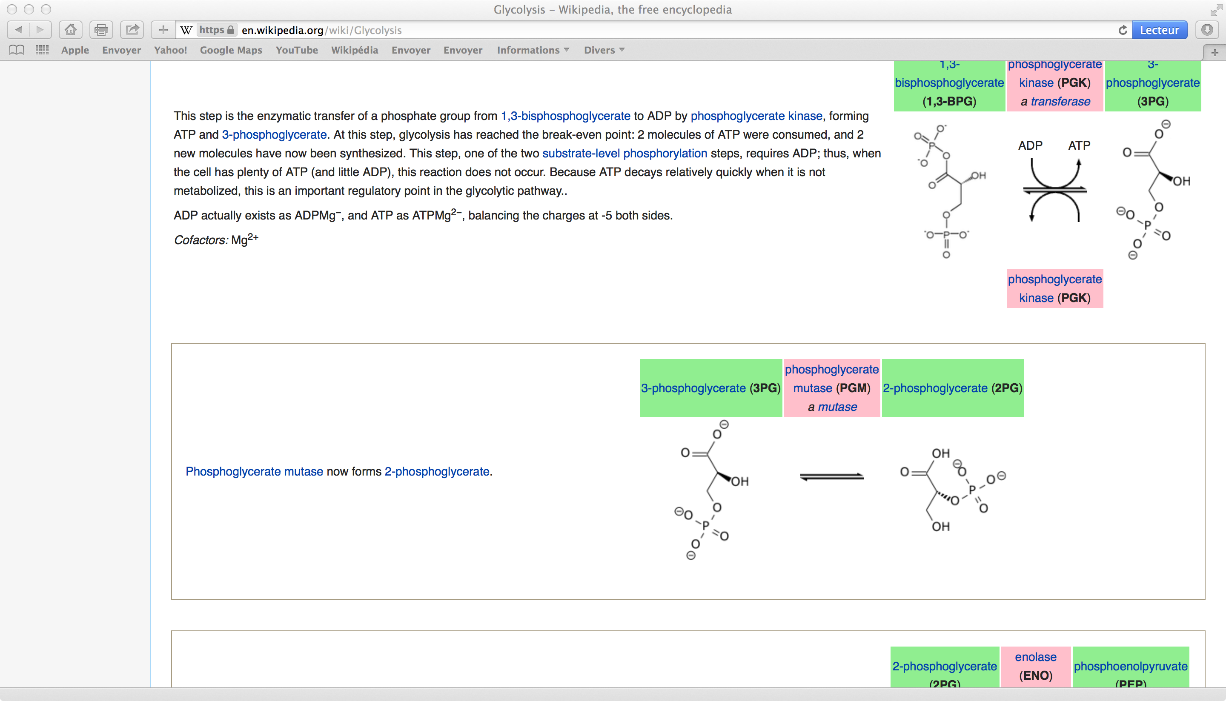
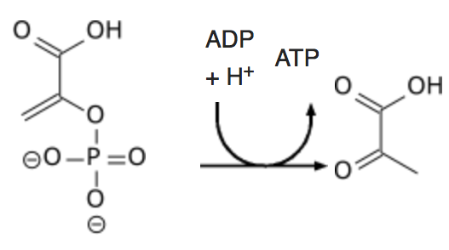
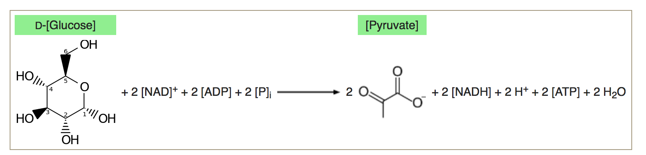
1-3 Bisphosphoglycerate
3 Phosphoglycerate
Phosphoénolpyruvate
Pyruvate
+H⁺
+H⁺
(2PG
Isomerization)
-
-
(+H₂0)
-2+2
-2
+1 +1 +2 -2 = 2 so producing
2 pyruvates from Glucose produces 2H⁺

Slide 3
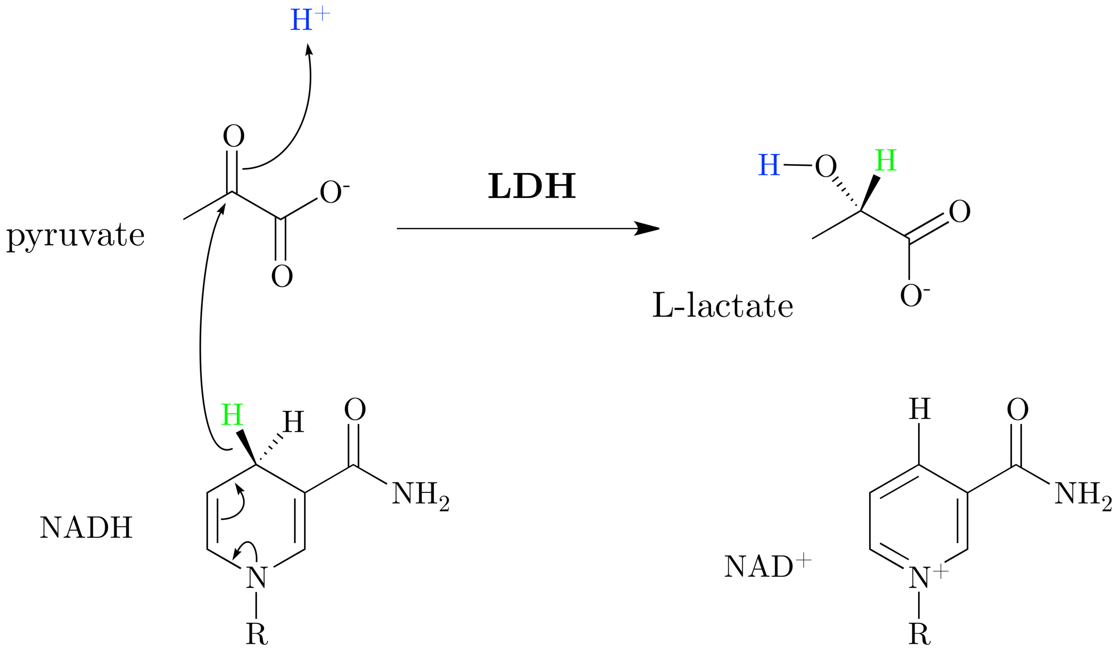
What about Lactate formation ?
- 2
Glucose to pyruvate : + 2 and pyruvate to Lactate : -2
After lactate formation there are no protons left.
Lactate formation is in fact a clever trick to remove the H⁺ ions produced by glycolysis (and to regenerate NAD+)
That’s why many eukaryotic organisms and tumor cells can be happy without oxygen.

Slide 4
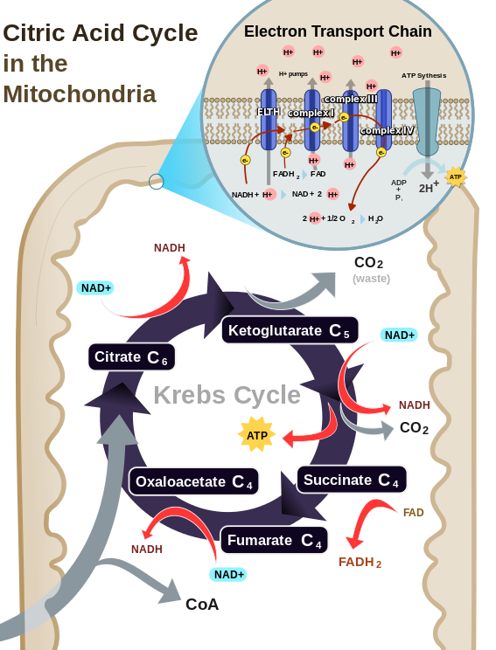
So why do cells become acidic in Hypoxia ?
We should never forget that we must consider the metabolic reactions to their very end
Lactate is not the end product of Glycolysis, it’s ATP
ATP
ADP + Pi + H+
It’s ATP consumption that yields 2 protons/ glucose in parallel with 2 lactate molecules whose production does not produce any proton
What happens to the protons produced by ATP hydrolysis in Normoxia???
In Normoxia a large fraction of the protons produced by ATP hydrolysis is consummed by mitochondrial respiration wherethe final H⁺ (and e⁻) acceptor is 0₂

